Slide 1




PEOPLE’S COMMITTEE OF TAN BINH DISTRICT
CHI LANG PRIMARY SCHOOL
Grade: 2
UNIT 1: FEELINGS
Teacher: Hoàng Thị Thanh Thảo

Slide 2
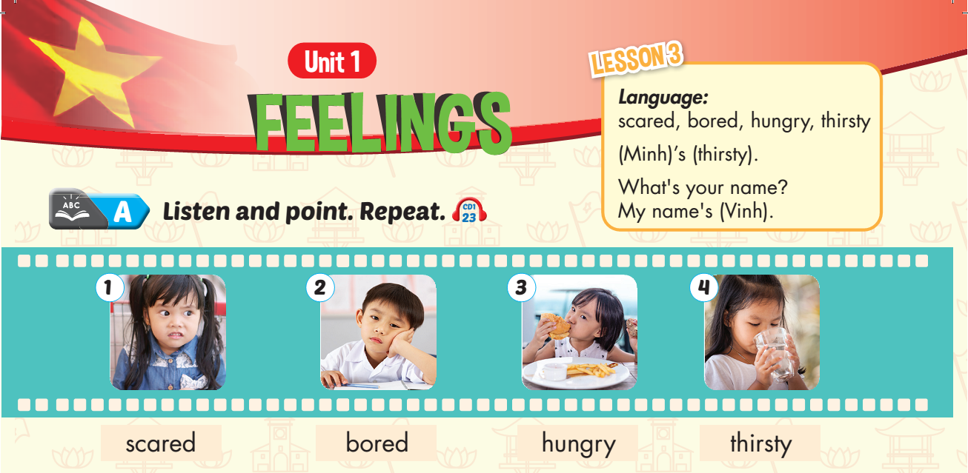

Lesson 1
Notes:
Click on the words, they will move and match up with the pictures.

Slide 3
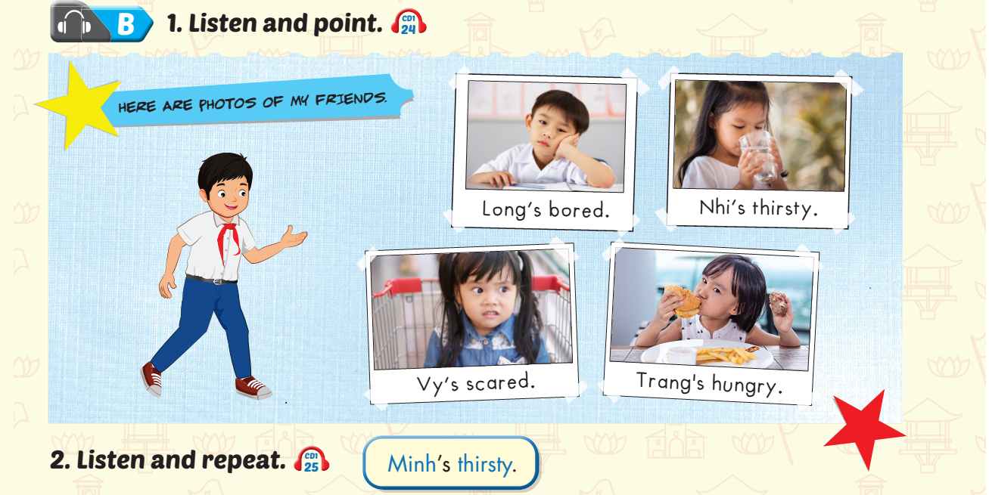
Lesson 1
Notes:
Click on the words, they will move and match up with the pictures.

Slide 4
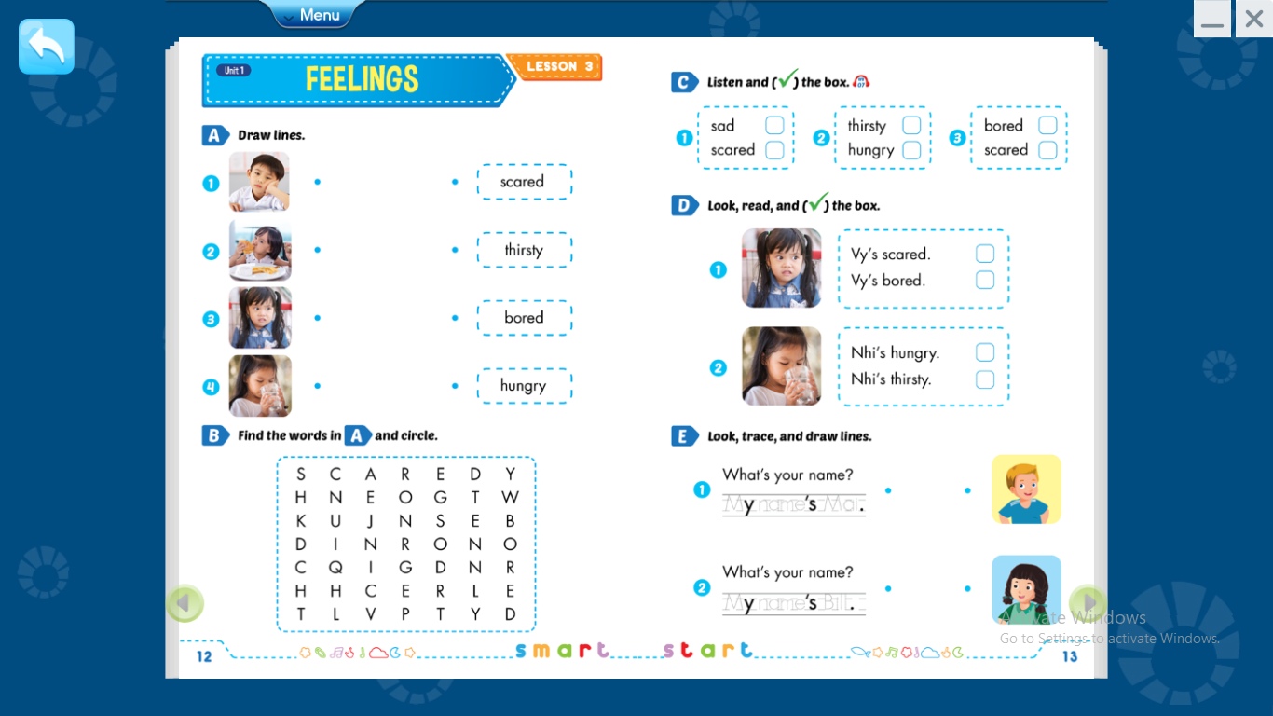

Slide 5


Lesson 1
$$√$$
$$√$$
Notes:
Click on the words, they will move and match up with the pictures.

Slide 6
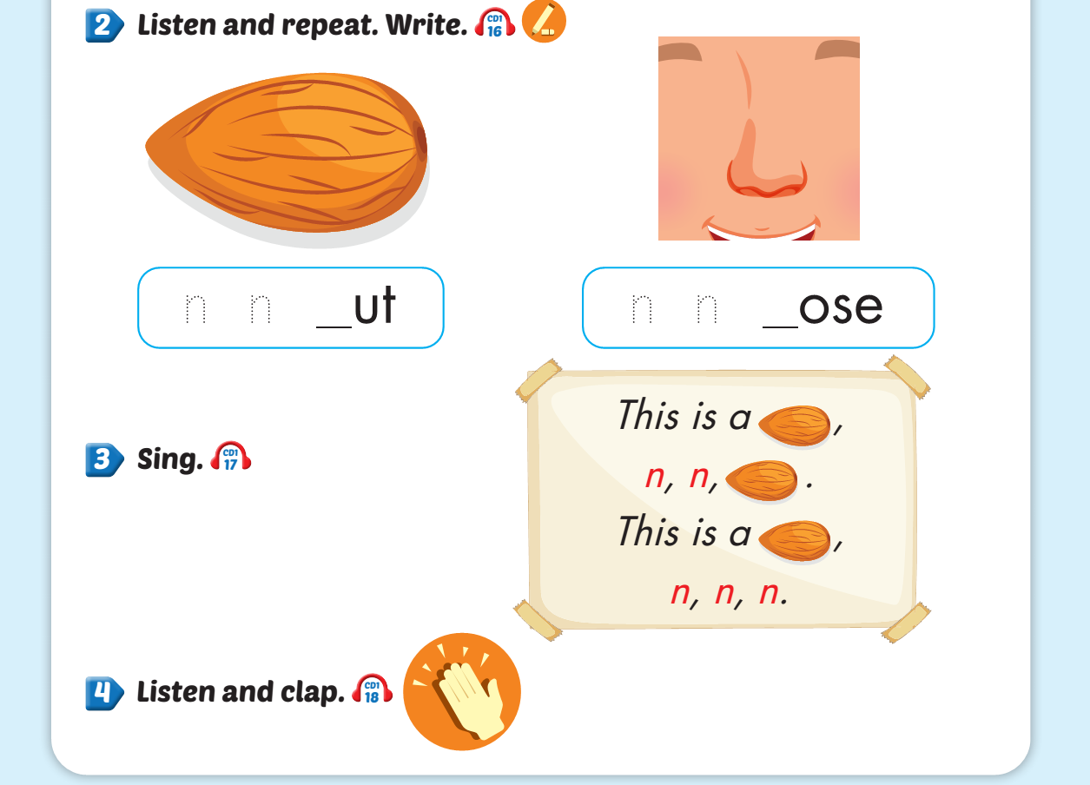
Lesson 1
Notes:
Click on the words, they will move and match up with the pictures.

Slide 7
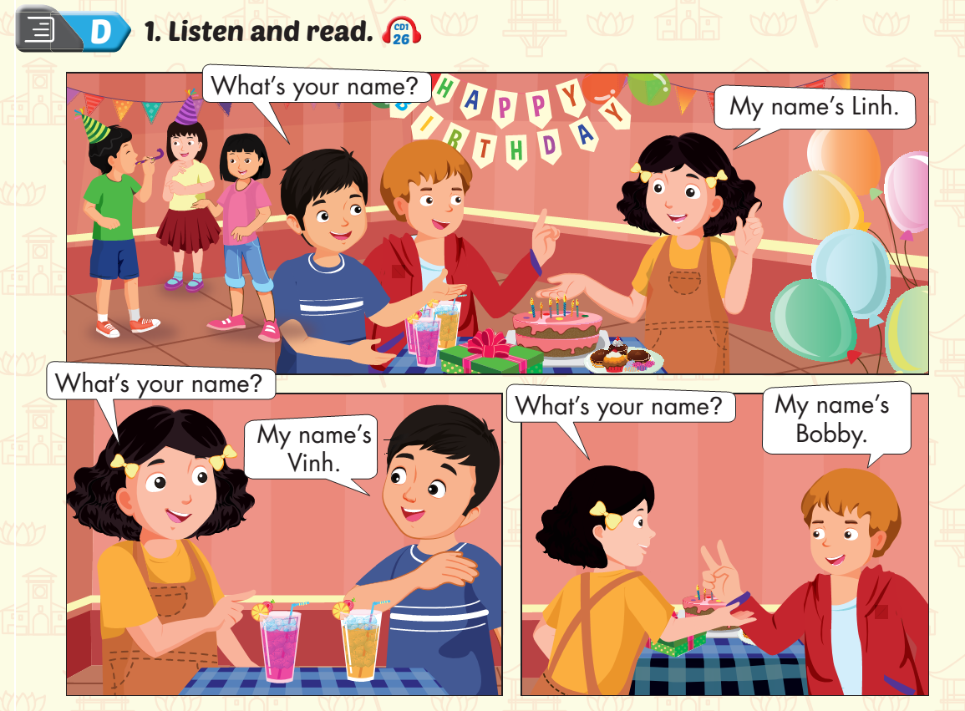
Lesson 1
Notes:
Click on the words, they will move and match up with the pictures.

Slide 8
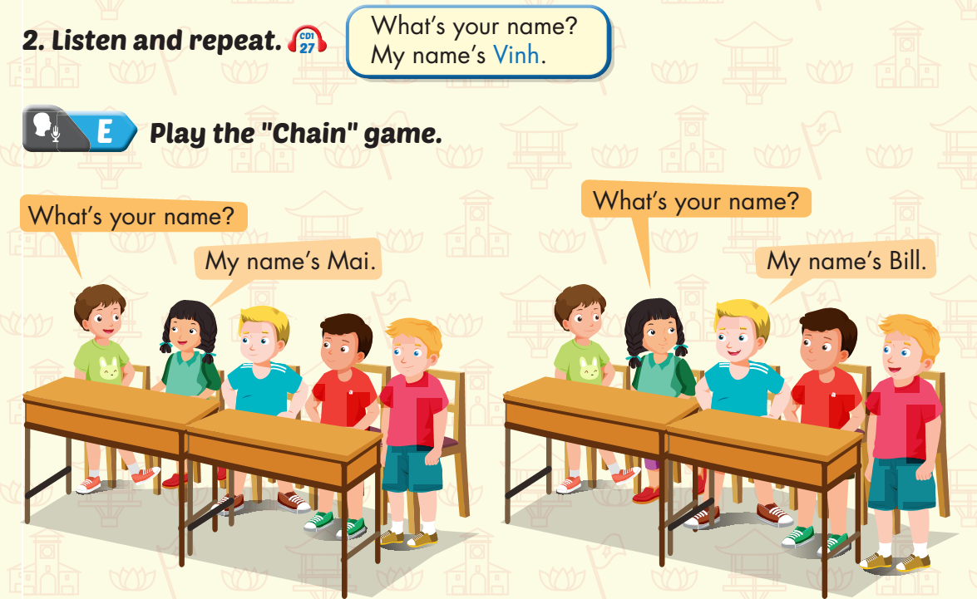
Lesson 1
Notes:
Click on the words, they will move and match up with the pictures.

Slide 9

Lesson 1
Notes:
Click on the words, they will move and match up with the pictures.

Slide 10






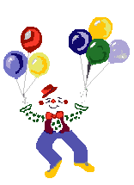
Thank you for enjoying
the lesson !

